Slide 1
70-533 : Implementing Microsoft Azure Infrastructure Solutions

Slide 2
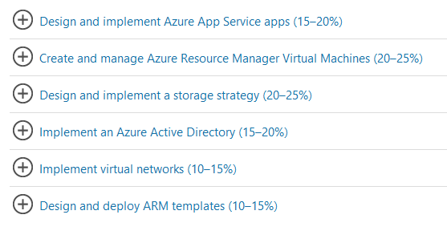
70-533 : Implementing Microsoft Azure Infrastructure Solutions

Slide 3
Implement Blobs, tables and Azure Files and Queue

Slide 4
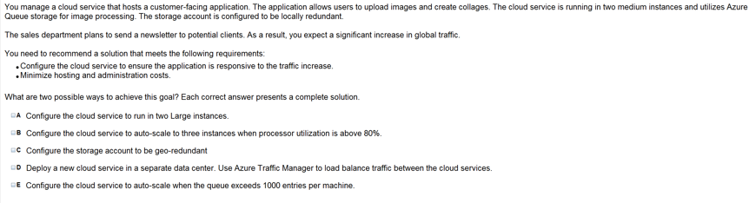

Slide 5
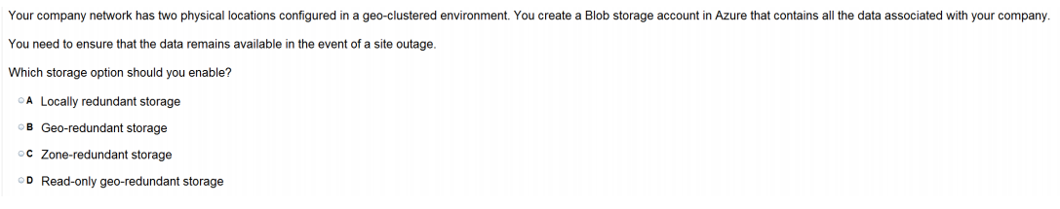

Slide 6
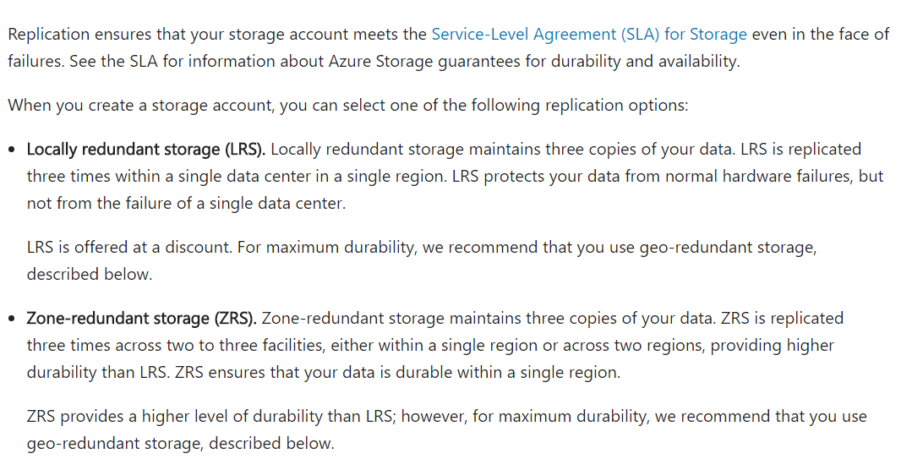

Slide 7
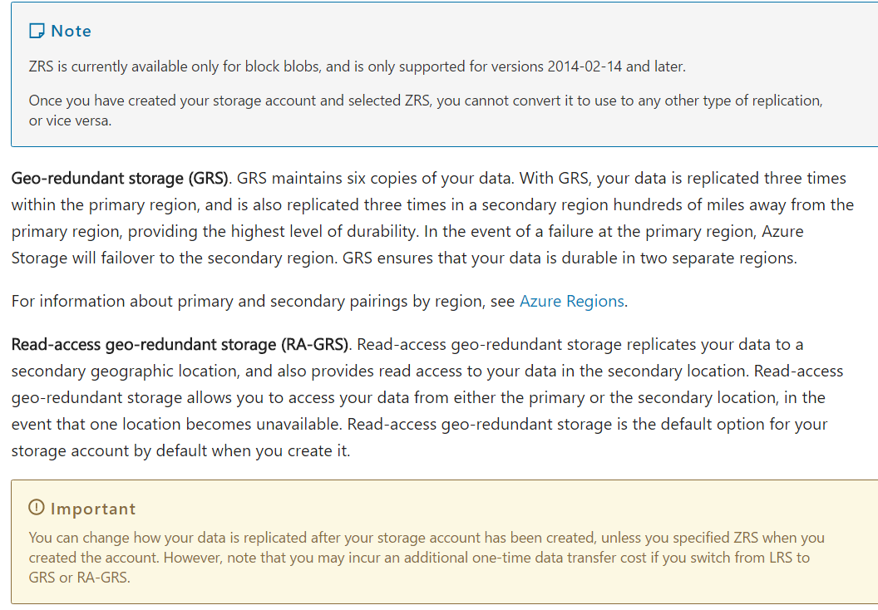

Slide 8
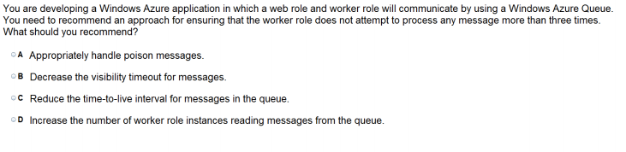

Slide 9
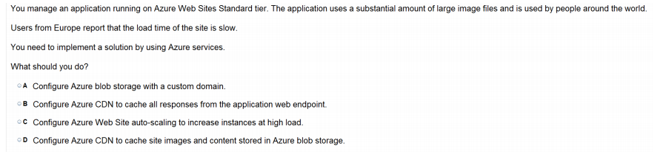

Slide 10
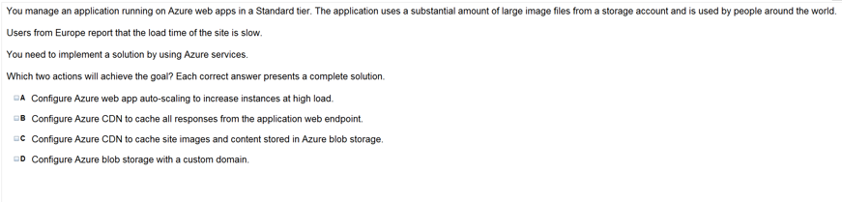

Slide 11
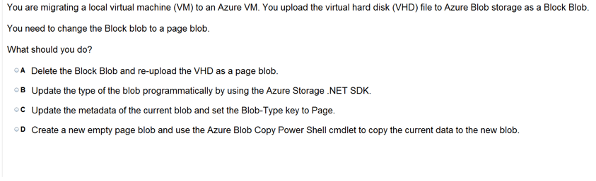

Slide 12
For migrating your local virtual machine (VM) to an Azure VM. You upload (VHD) file to Azure Blob storage as a Block Blob. Now need to change the Block Blob to a page blob. What options ?
A. Delete the Block Blob and re-upload the VHD as a page blob.
B. Update the type of the blob programmatically by using the Azure Storage .NET SDK.
C. Update the metadata of the current blob and set the Blob-Type key to Page.
D. Create a new empty page blob and use the Azure Blob Copy Power Shell cmdlet to copy the current data to the new blob.

Slide 13
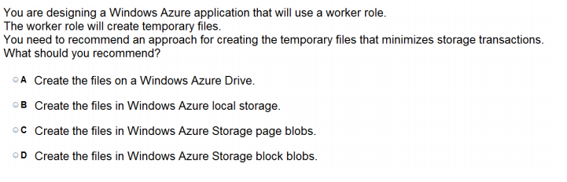

Slide 14
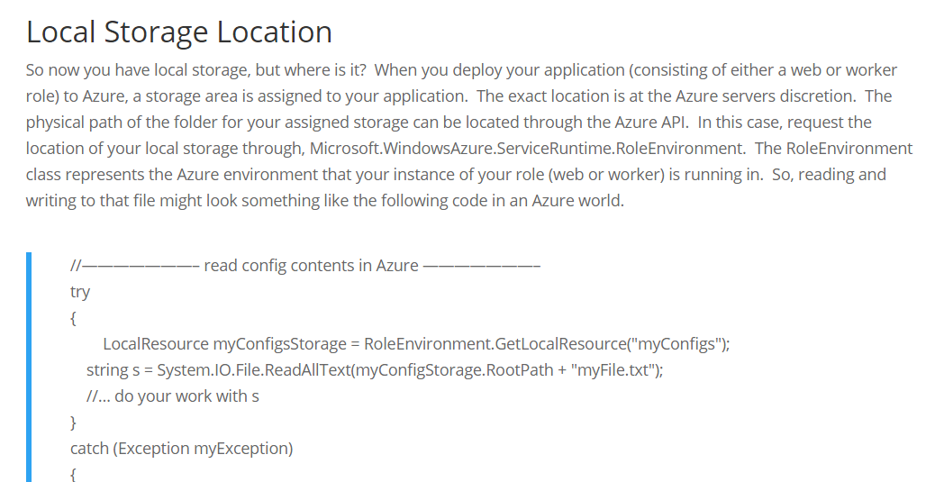

Slide 15
Manage Access

Slide 16
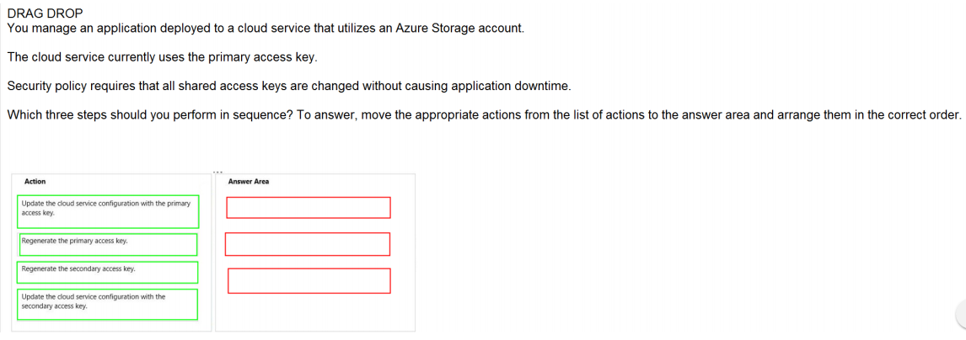
Ans =

Slide 17
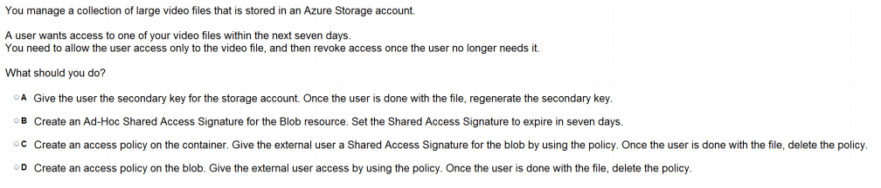

Slide 18
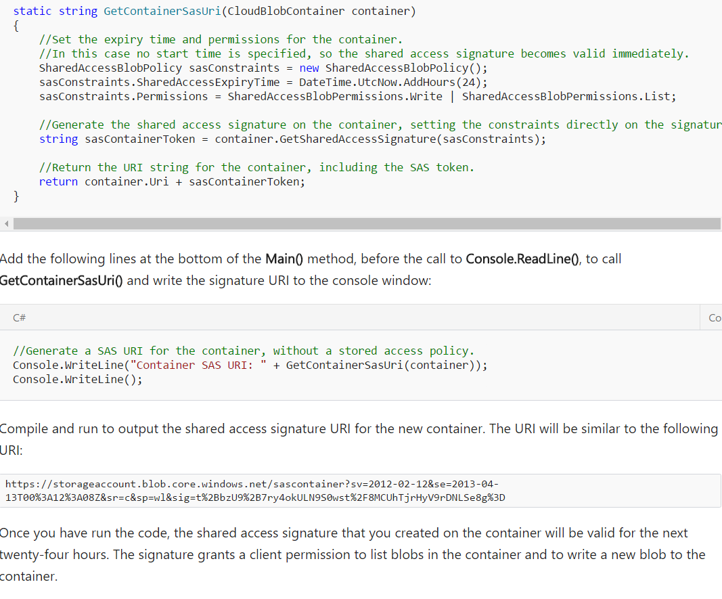

Slide 19
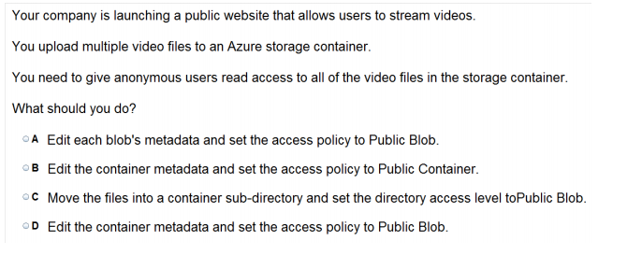

Slide 20
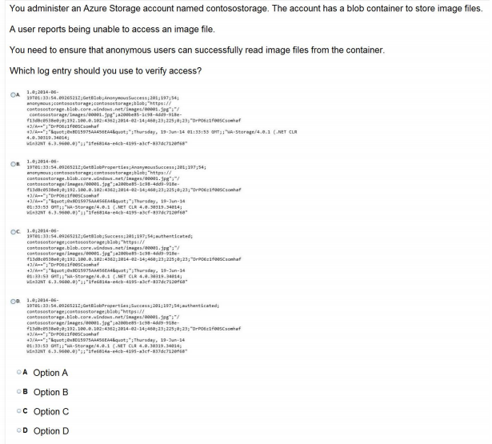


Slide 21

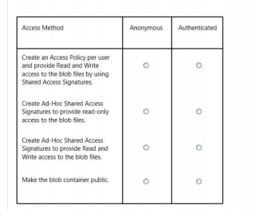
Ans =

Slide 22
Implementing SQL Database and Tables

Slide 23
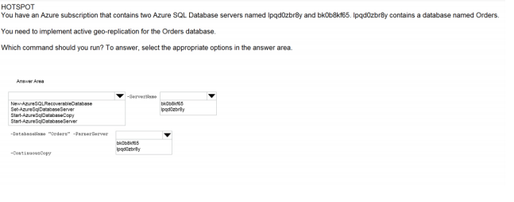
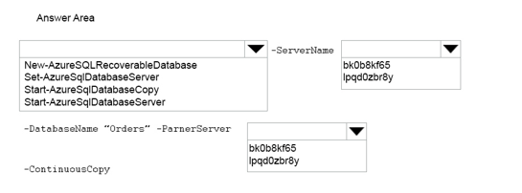

Slide 24
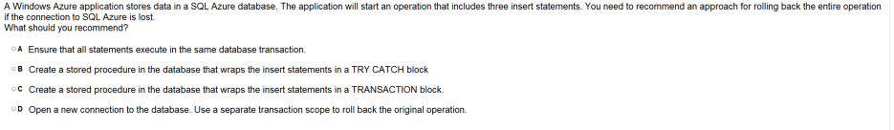

Slide 25
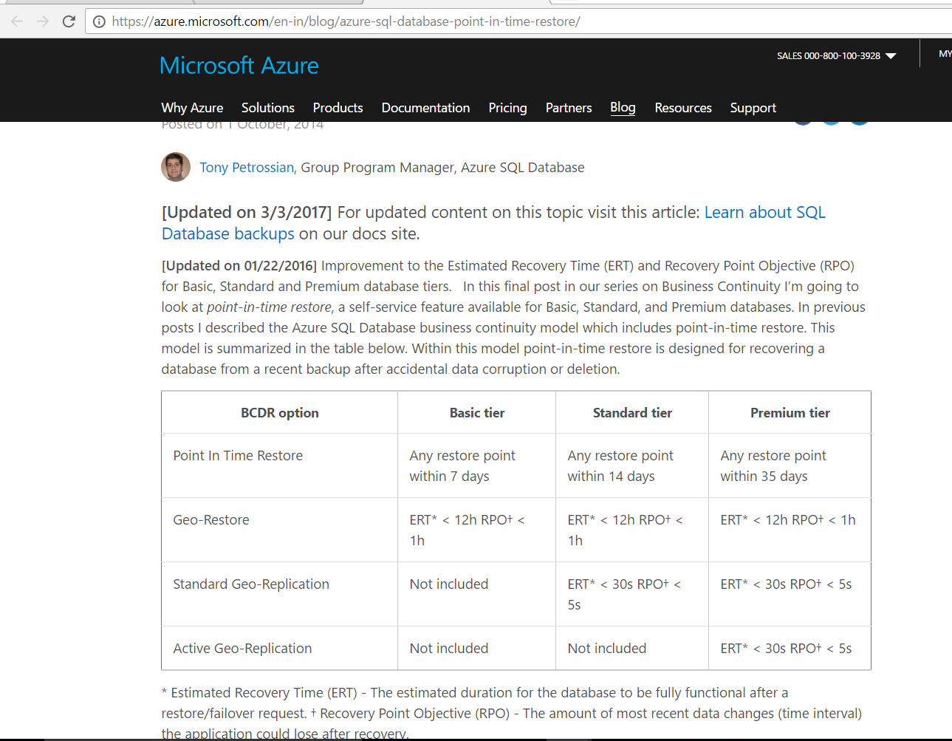

Slide 26
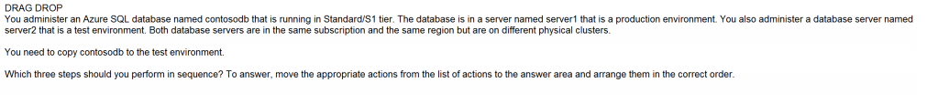
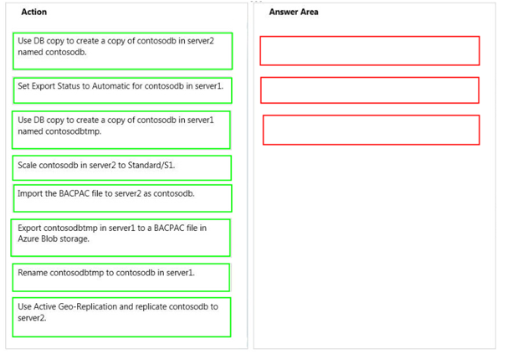
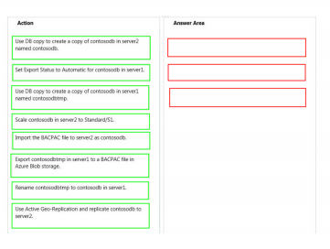
Ans =

Slide 27
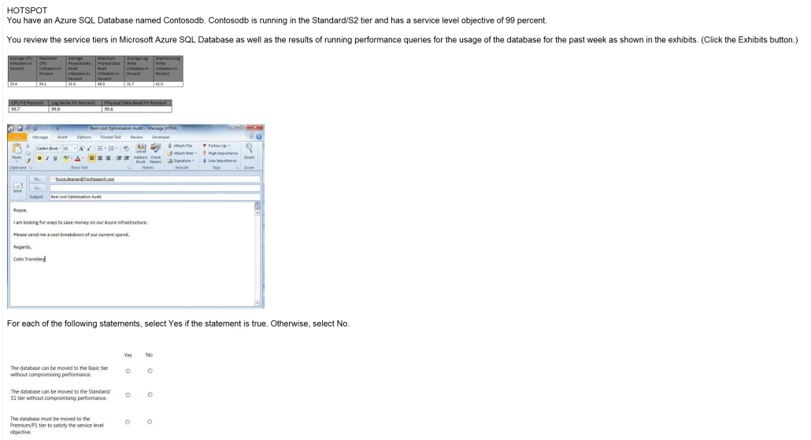
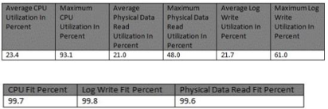
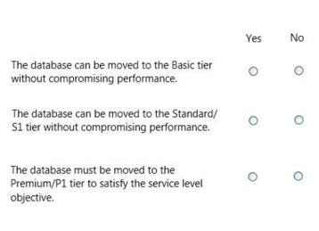
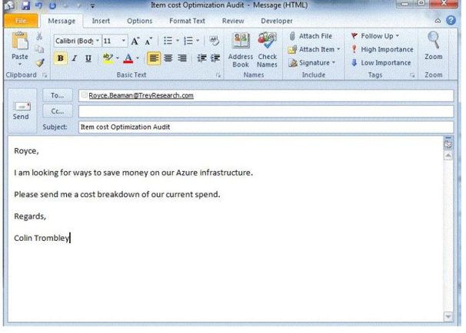

Slide 28
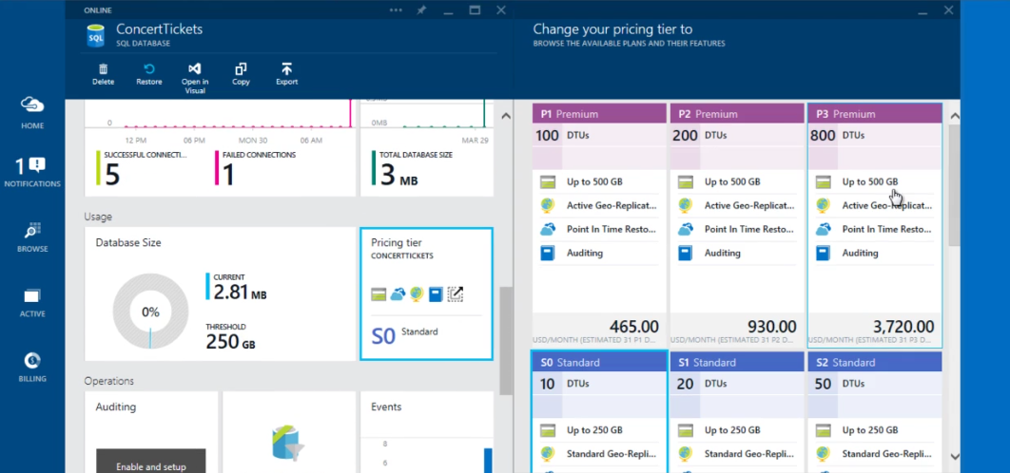
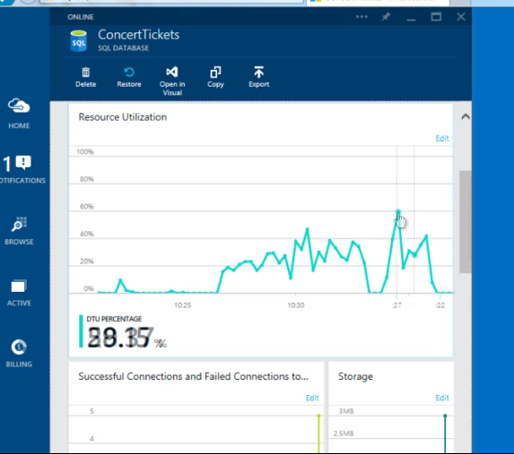

DTU
Resource Utilization Graph
https://docs.microsoft.com/en-us/azure/sql-database/sql-database-service-tiers

Slide 29
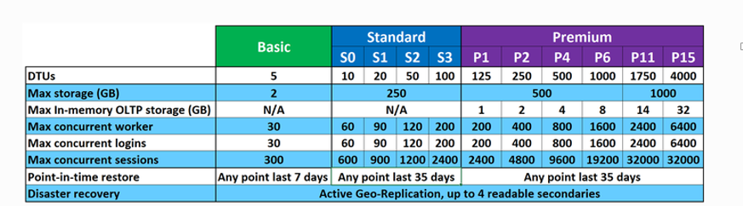
Within the standard and premium tiers, you can see there are different performance levels available. Performance of Azure SQL Database is measured in DTUs. DTUs provide a way to describe the relative capacity of a performance level of Basic, Standard, and Premium databases. DTUs are based on a blended measure of CPU, memory, reads, and writes. As DTUs increase, the power offered by the performance level increases. For example, a standard tier performance level of S0 with 10 DTUs has half the power of a standard tier S1 with 20 DTUs. As you move higher up the performance level ladder you also gain better predictability of performance.
Explanation: * The P1 performance level has 100 DTUs compared to the 200 DTUs of the P2 performance level. That means that the P1 performance level provides half the performance of the P2 performance level. So 50% of CPU utilization in P2 equals 100% CPU utilization inP1. As long as the application does not have timeouts, it may not matter if a big job takes 2 hours or 2.5 hours to complete as long as it gets done today. An application in this category can probably just use a P1 performance level.

Slide 30

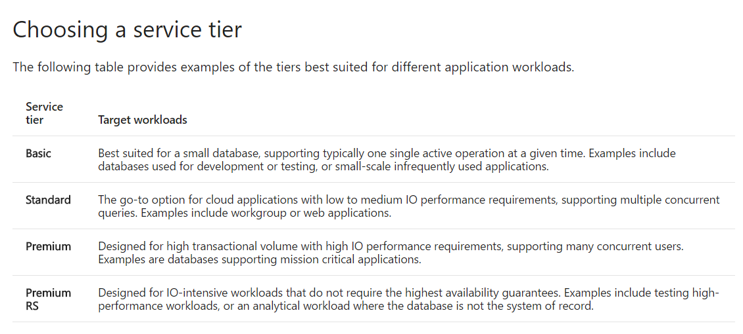

Slide 31
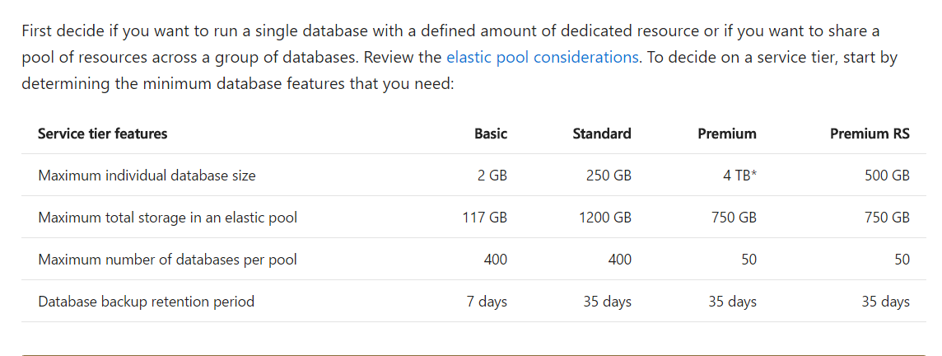

Slide 32
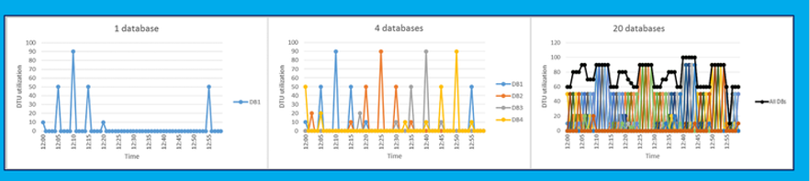
<click> The Rule of thumb: A database is a good candidate for an elastic pool when peak utilization is 1.5x of average utilization

Slide 33
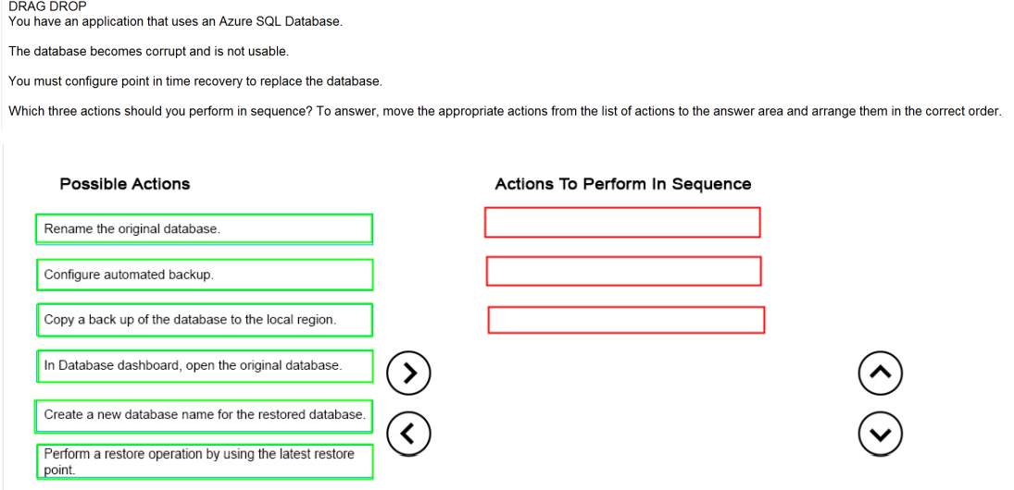
Ans =

Slide 34
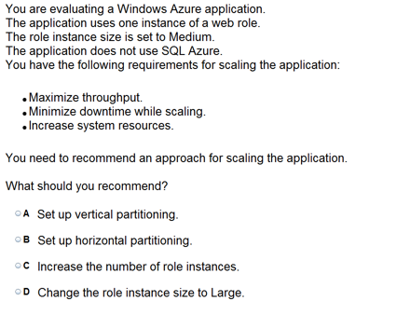

Slide 35
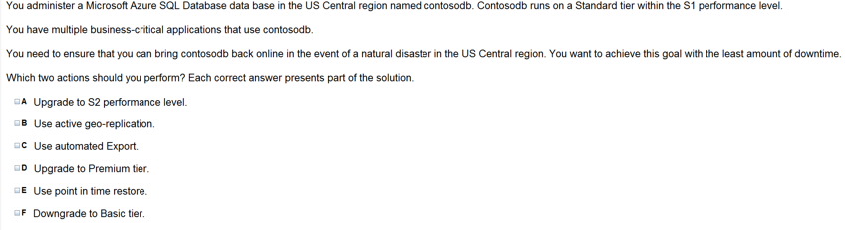

Slide 36
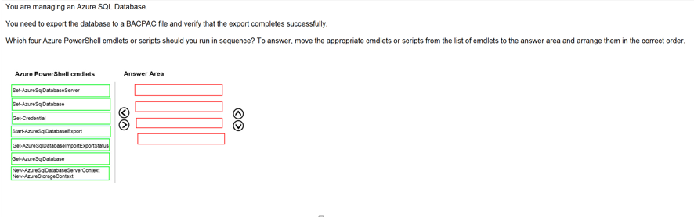
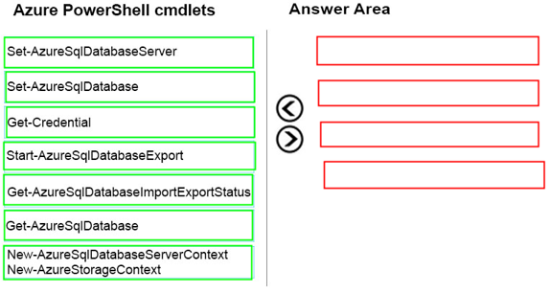
Ans =

Slide 37
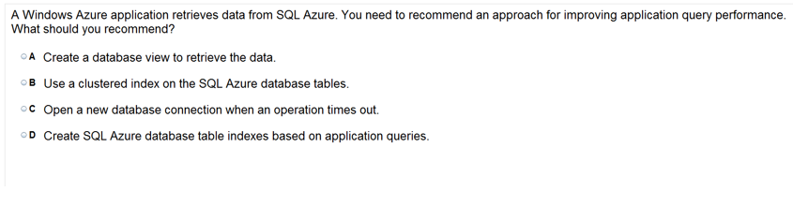

Slide 38
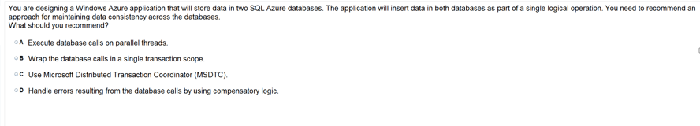

Slide 39
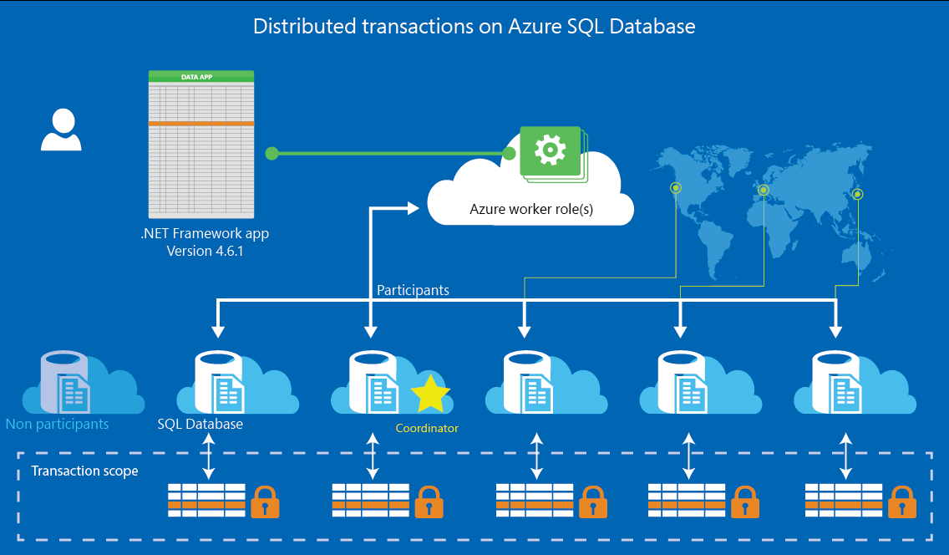
Whats not in Azure SQL –
http://www.mariner-usa.com/blog/considerations-using-azure-sql-database/

Slide 40
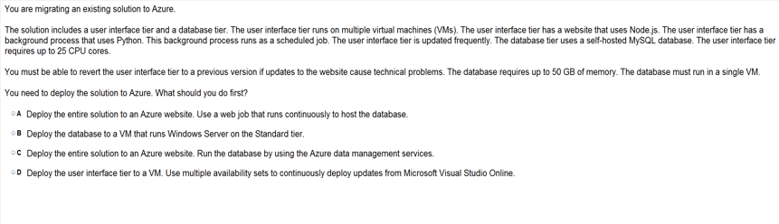

Slide 41
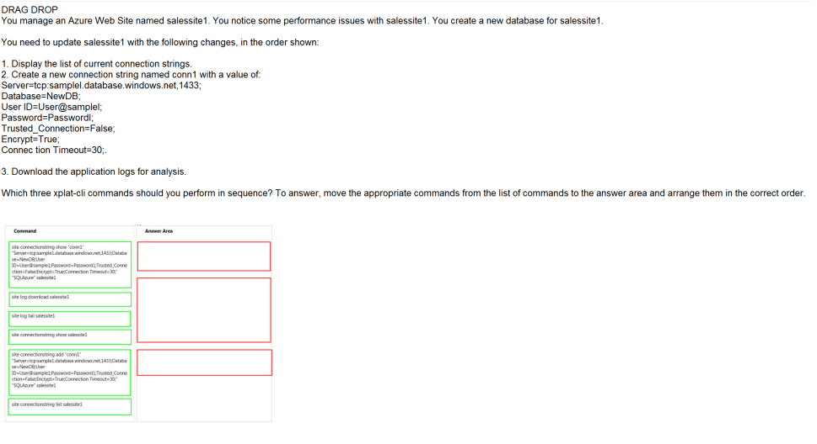
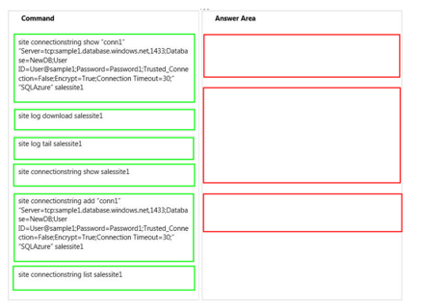
Ans =

Slide 42
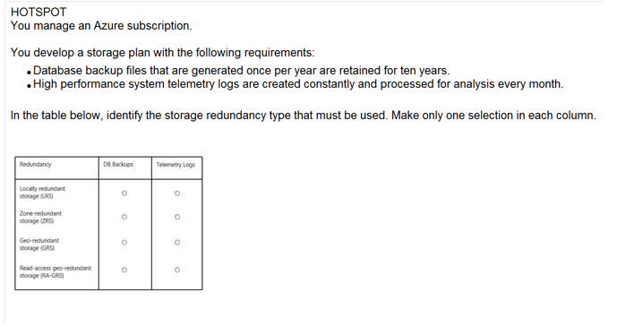
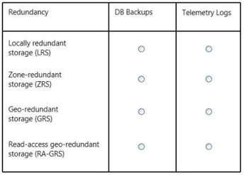
Ans =

Slide 43
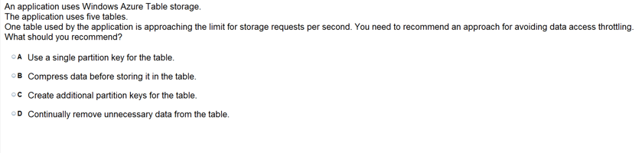

Slide 44
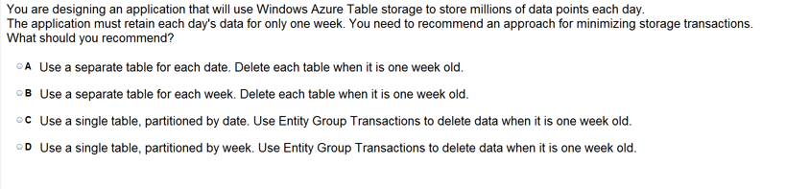

Slide 45
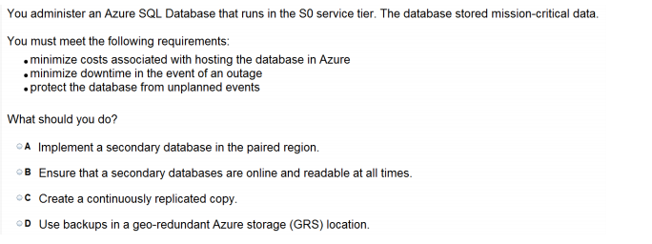

Slide 46


Slide 47


Slide 48
Configure Diagnostics, Monitoring and Analytics

Slide 49

The Set-AzureStorageServiceLoggingProperty cmdlet modifies logging for Azure Storage services.
C:\PS>Set-AzureStorageServiceLoggingProperty -ServiceType Blob -LoggingOperations Read,Write -PassThru -RetentionDays 10 -Version 1.0

Slide 50


Slide 51


Slide 52


